Slide 1
Introducing the Euro in Times of High Inflation: the Case of Croatia
Boris Vujčić, Governor
Geneva, 9 March 2023

Slide 2
Overview
The euro adoption process - then and now
Challenges in the context of high inflation
Benefits of adopting the euro for a small EU Member State

Slide 3
The euro adoption process – then and now

Slide 4
Until 2008, the path towards the euro was fairly simple
EU Member States interested in joining the euro area only had to fulfil the nominal convergence criteria (the Maastricht criteria) ...
price stability
stable and sound public finances
exchange rate stability (during the two-year participation in ERM II)
convergence of long-term interest rates
... and achieve the required degree of legal convergence
central bank independence
prohibition of monetary financing and privileged access of the public sector to financial institutions
There were no preconditions for joining ERM II
new EU Member States that were willing to launch the euro adoption process were allowed to start participating in ERM II soon after they joined the EU in May 2004

Slide 5
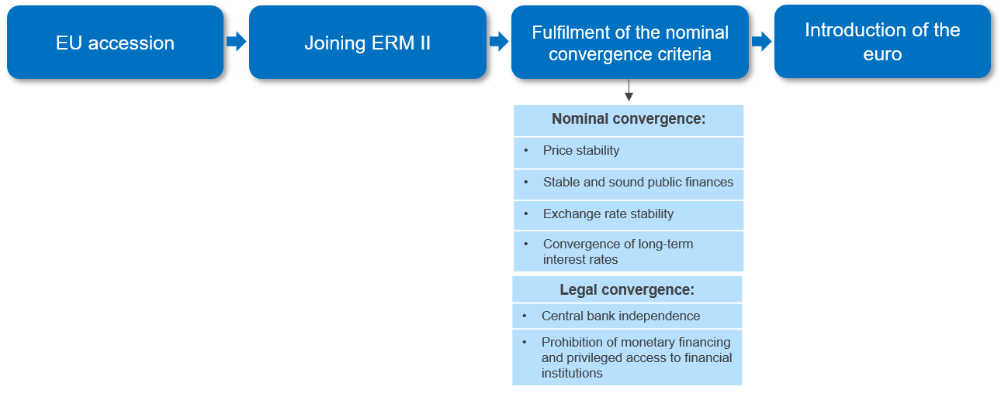
The euro adoption process - then

Slide 6
However, the process has become much more demanding after the 2008-09 global financial crisis
Unfavourable developments in the euro area following the outbreak of the GFC inspired a significant overhaul of the EU’s institutional framework
Banking union (though not yet completed)
Macroeconomic Imbalances Procedure
European Semester (EU Council country-specific recommendations - CSRs)
Countries wishing to join the euro area are expected to be aligned with the EU’s new institutional features even before they join ERM II
Croatia’s path towards the ERM II participation is a case in point

Slide 7
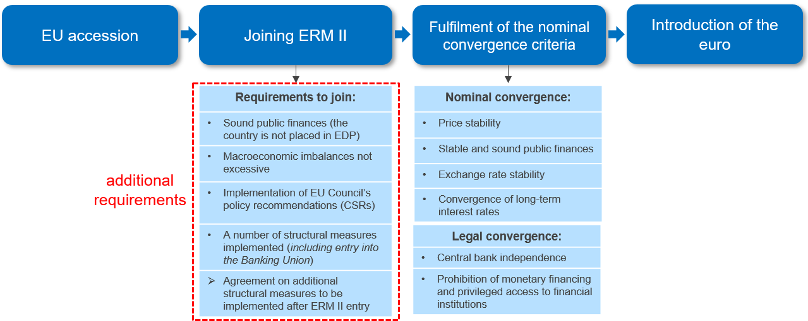
The euro adoption process - now

Slide 8
In addition to being subject to a stricter formal procedure, Croatia was also hit by severe shocks on its road to the euro
After Croatia had made its first steps towards the euro, the country was hit by a number of severe shocks that brought additional challenges to the authorities
COVID-19 outbreak (early 2020)
Zagreb earthquake (March 2020)
Petrinja earthquake (December 2020)
surge in global inflation (2021/2022)
before ERM II entry
(July 2020)
adoption of the Euro Changeover Plan (December 2020)
before the assessment of the convergence criteria (May 2022)

Slide 9
Despite all this, Croatia managed to adopt the euro in the shortest possible time




1 July 2013
10 July 2020
1 June 2022
1 January 2023
5 years after the publication of the Euro adoption strategy

Slide 10
Challenges in the context of high inflation

Slide 11
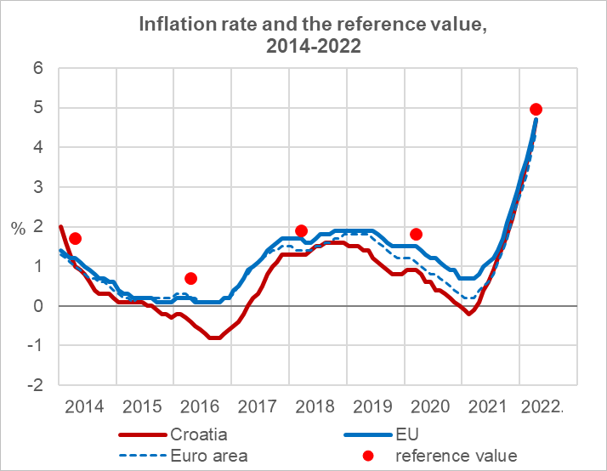
In the high-inflation environment, the price stability criterion was the greatest challenge among the nominal convergence criteria
Since its EU accession, Croatia has continuously been compliant with the price stability criterion
in fact, since 2016 Croatia was de facto compliant with all convergence criteria
However, global inflationary pressures that emerged in 2021 and further intensified in 2022 called into question Croatia’s ability to meet the criterion
Source: Eurostat

Slide 12
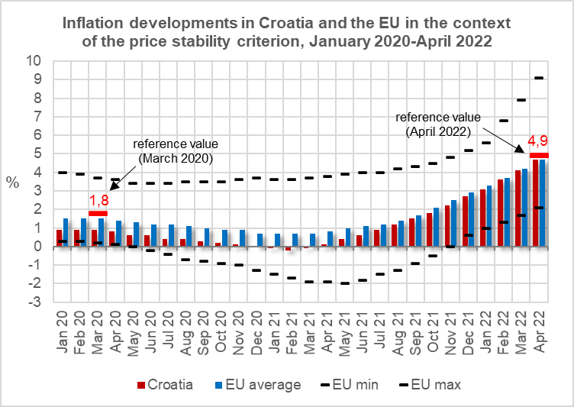
Croatia nevertheless fulfilled the price stability criterion
Dispersion in inflation rates among EU Member States was historically high in spring 2022
Given that inflation had picked up in most other Member States as well, the reference value increased significantly, enabling Croatia to meet the criterion
in April 2022, the 12m average inflation rate in Croatia (4.7%) was slightly lower than the reference value (4.9%)
Therefore, in the Convergence Report of 1 June 2022 the Commission, as well as the ECB, assessed that Croatia had fulfilled the price stability criterion
Source: Eurostat

Slide 13
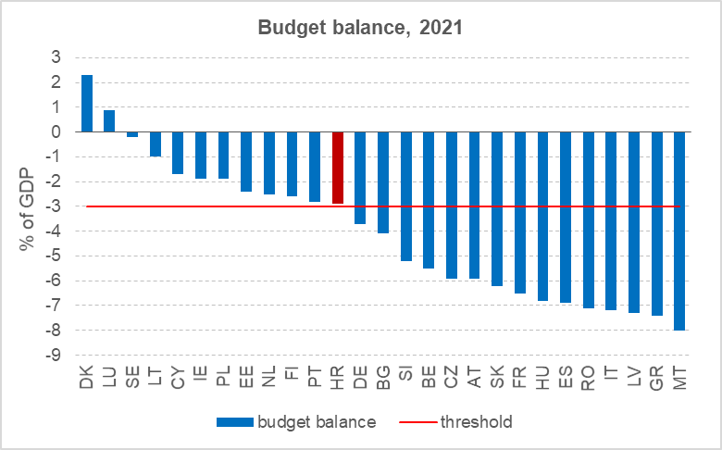
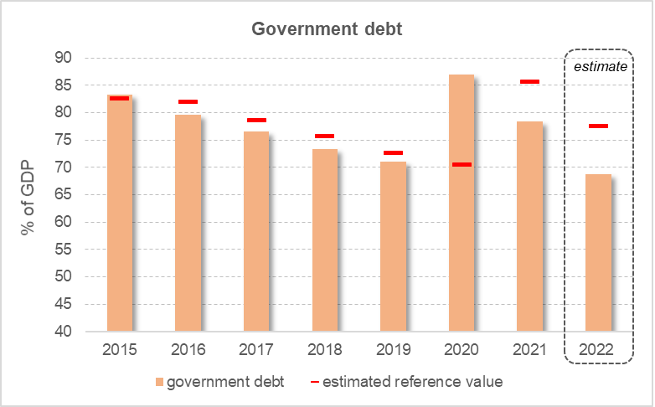
Croatia fulfilled other nominal convergence criteria as well: Stable and sound public finances
In 2021, Croatia had a budget deficit
of below 3% of GDP ...
... while the debt-to-GDP ratio fell by as much as 7.5 percentage points
Source: Eurostat
Source: HNB
 Even if the reference values for the budget balance and government debt for 2021 had been breached, Croatia would have fulfilled this criterion because the EU’s fiscal rules have been suspended since March 2020 in response to the outbreak of the COVID-19 pandemic (the so-called „general escape clause” was activated).

Slide 14
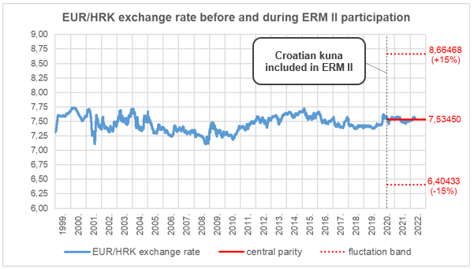
Croatia fulfilled other nominal convergence criteria as well: Exchange rate stability
During the participation in ERM II, the EUR/HRK exchange rate
fluctuated very close to the central parity
Source: CNB

Slide 15
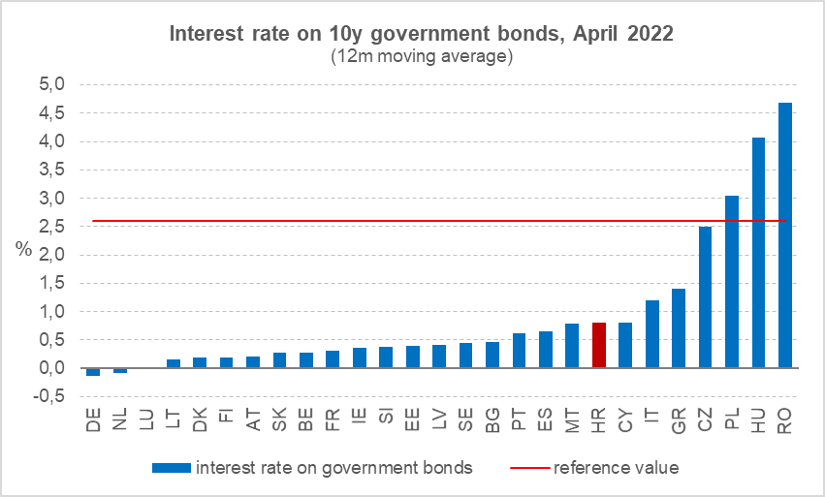
Croatia fulfilled other nominal convergence criteria as well: Convergence of long-term interest rates
Source: Eurostat

Slide 16
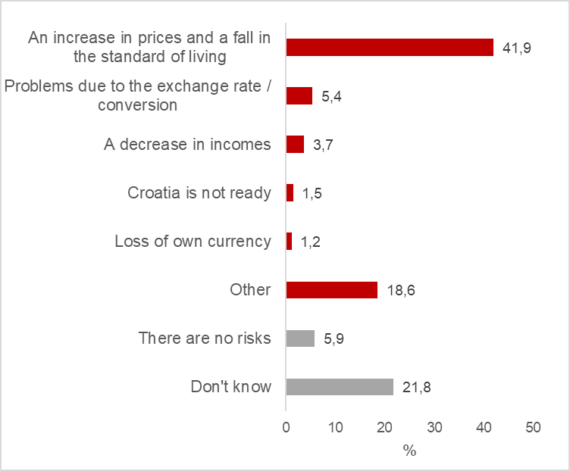
High inflation has reinforced the (incorrect) public perception of the negative impact of the euro on living standards
PUBLIC OPINION SURVEY (2021): What is the greatest risk of euro introduction?
Before the adoption of the euro, a possible substantial increase in the price level was considered by many Croatian citizens as the main disadvantage of the euro
Addressing such a negative public perception has been difficult given that the euro was introduced in the environment of already high inflation
Source: Ipsos, March 2021

Slide 17
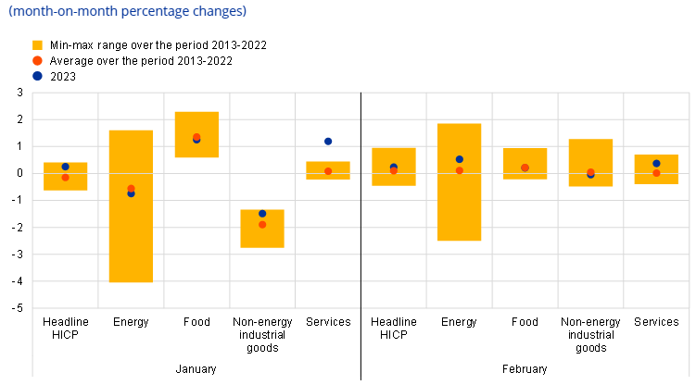
Increase in consumer prices due to rounding observed primarily in services sectors, ...
Price developments in early 2023 did not deviate much from the typical seasonal pattern observed over the previous 10 years
However, there was an unusually high m-o-m increase in prices of services in January 2023
bars, restaurants, hairdressers, dental and medical facilities have increased their prices the most
According to an ECB-HNB simulation, if the prices of services had followed the same pattern as in the previous 10 years, the overall inflation rate in January 2023 would have been lower by 0.4 percentage points
Headline HICP inflation and its main components in Croatia
Source: ECB

Slide 18
... while retail chains have complied with the rules on the conversion and rounding of prices
Pricing strategy in big retail chains in Croatia before and after the euro changeover
Prices of around 65% of products did not change after the euro changeover
a strong decrease in the share of so-called ”attractive” prices
It is likely that retailers will gradually set their prices at new attractive levels
these changes might occur as part of regular price adjustments
due to market competition and the obligation to display prices in both currencies by end-2023, the new attractive levels may not necessarily be higher
Source: ECB

Slide 19
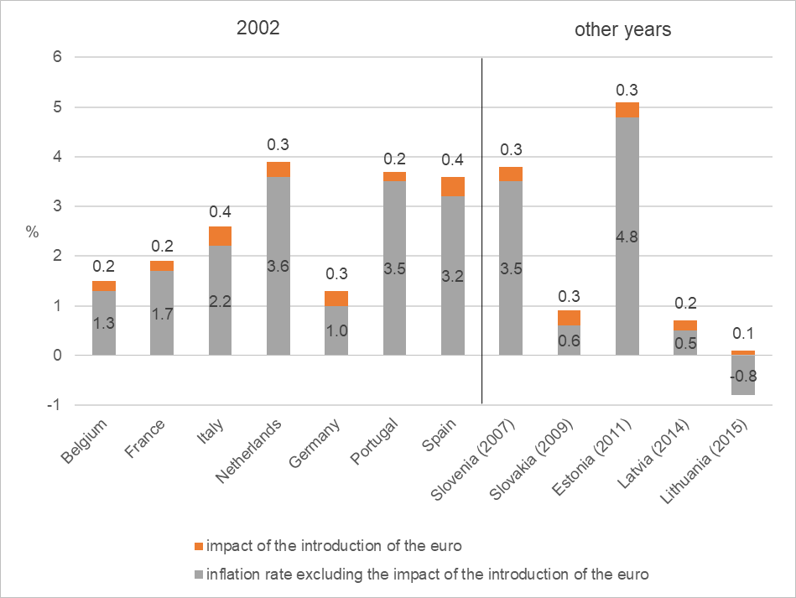
The impact on the aggregate price level was in line with the past experiences of other Member States
Impact of the euro on the inflation rate
(in the year of the introduction of the euro)
Croatia is the only Member State that introduced the euro in a period of very high inflation
Despite this, the estimated overall impact on prices was equally mild – 0.4 percentage points – as in Member States that had adopted the euro in a low-inflation environment
in their case as well, services sectors were the main driver of the overall euro-induced increase in prices
Sources: Eurostat; Pufnik, A. (2018.), MMF

Slide 20
Benefits of adopting the euro for a small EU Member State

Slide 21
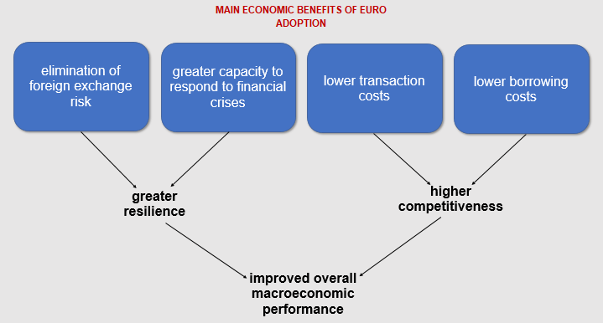
Euro adoption brings significant economic benefits to small and highly euroized EU Member States

Slide 22
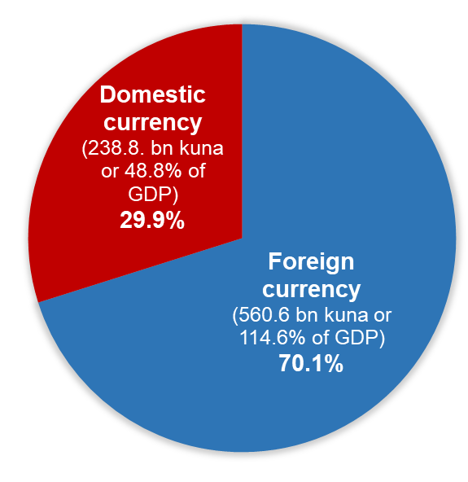
By adopting the euro, a Member State removes most of FX risk from the financial system and the economy
as a result, the country becomes more resilient to adverse shocks
This is particularly important for highly euroized countries such as Croatia
in contrast, it is less relevant for countries with low euroization levels (e.g. Poland and the Czech Republic)
Currency composition of total debt in Croatia, September 2022
Source: HNB

Slide 23
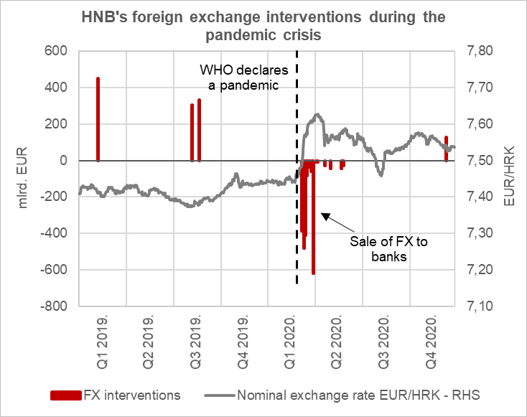
As part of the euro area a small country is more capable of coping with adverse shocks:
a currency crisis is no longer possible
domestic banks can access Eurosystem refinancing operations
it can benefit from the Eurosystem’s unconventional monetary policy measures
it enjoys higher credibility in financial markets
it can access ESM financing in case of debt refinancing difficulties
Pressures in the FX market no longer possible after the adoption of the euro
Source: HNB

Slide 24
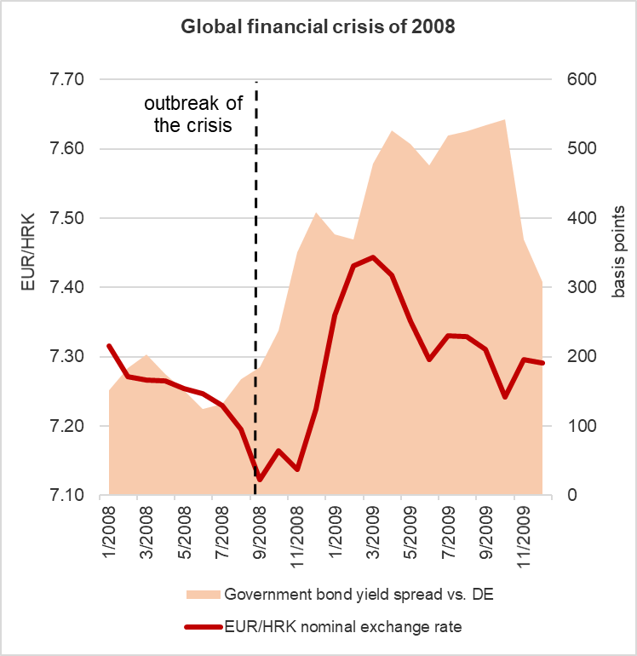
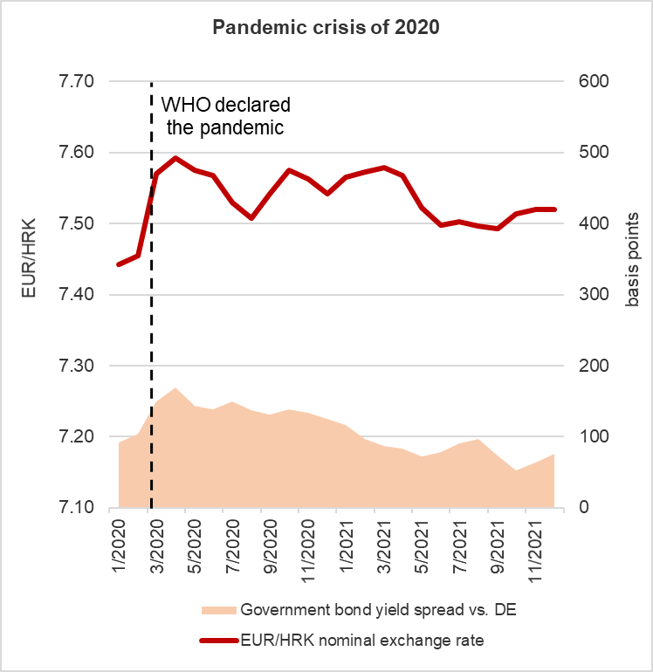
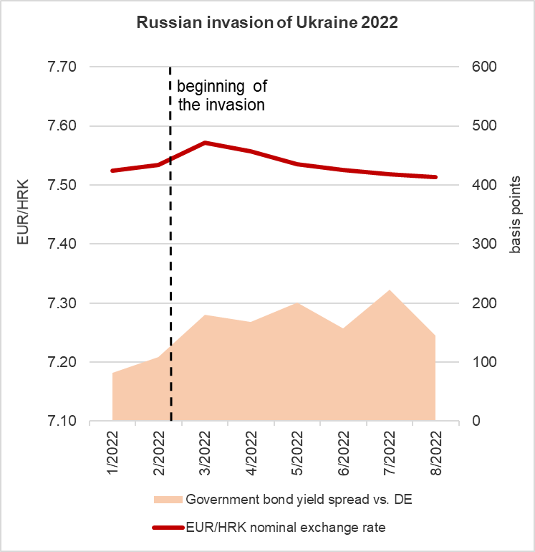
The euro adoption process itself made Croatia more resilient to shocks:
Source: HNB

Slide 25
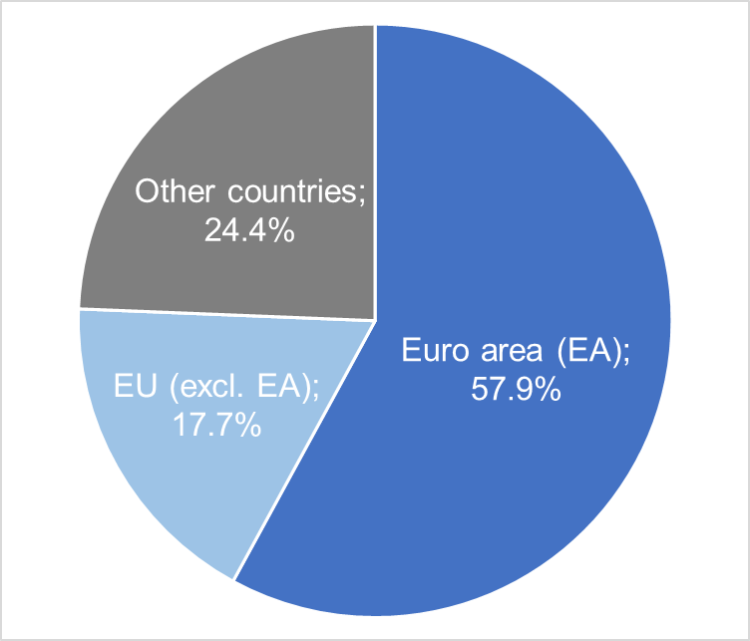
Geographical composition of Croatia’s international trade, 2021
Euro adoption eliminates currency conversion costs
the resulting cost savings are particularly large in countries with strong trade links with the euro area, such as Croatia
The positive effects on the economy are multiple:
the cost efficiency of firms engaged in foreign trade increases ...
... thus facilitating further trade as well as financial integration ...
... while a positive impact is expected also in certain sectors of tradable services (especially tourism)
Source: Eurostat

Slide 26
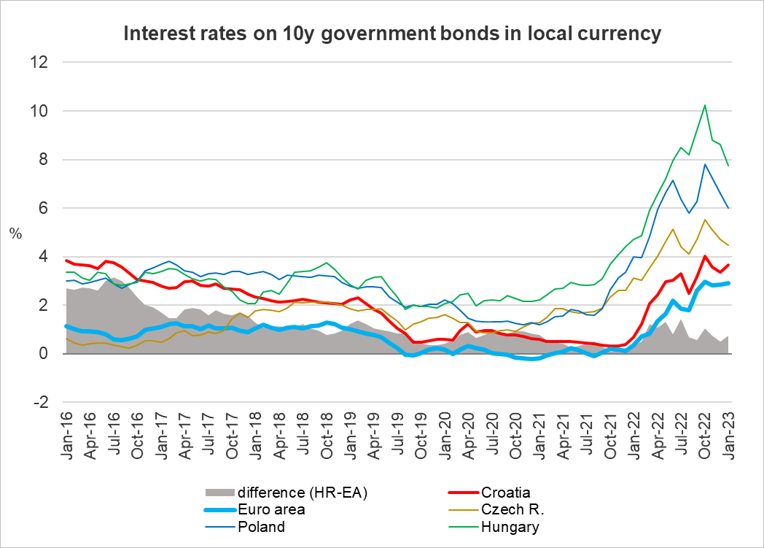
Euro adoption can lead to a reduction in borrowing costs through 2 channels:
lower country risk premium
greater resilience to shocks implies higher credibility in financial markets and therefore lower sovereign yields
lower regulatory costs for the banking system
the minimum reserve requirement rate in the EA is only 1%
most countries maintain tighter regulatory requirements before they adopt the euro – these requirements have to be relaxed
Croatia’s sovereign yield spread has declined since 2016 supported by the progress towards the euro
Source: Eurostat

Slide 27
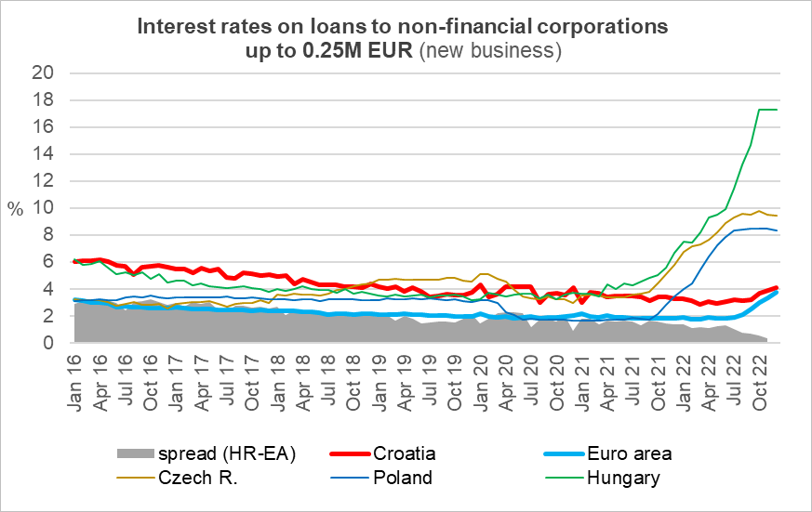
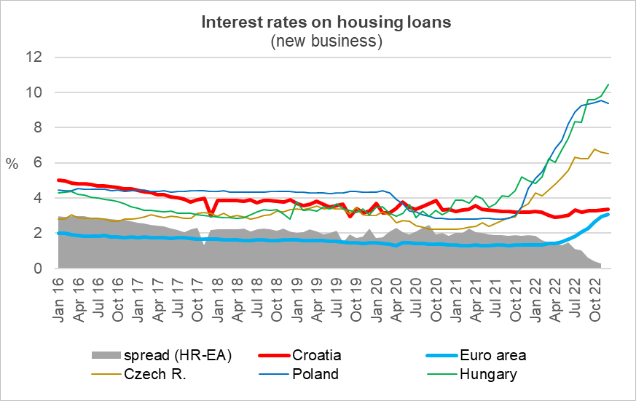
The private sector has already felt the positive effects of the euro on financing conditions:
Source: ECB SDW
Source: ECB SDW

Slide 28
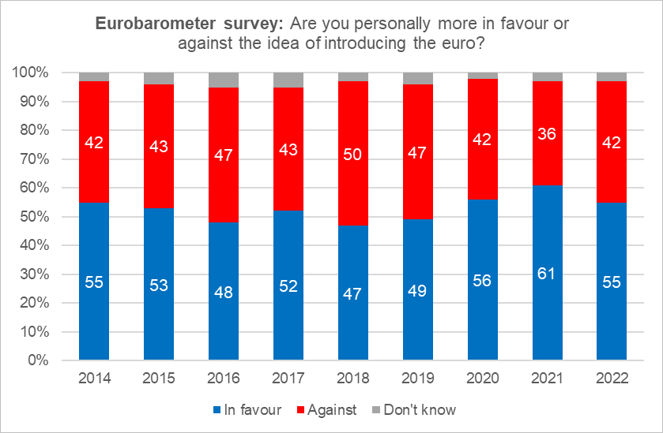
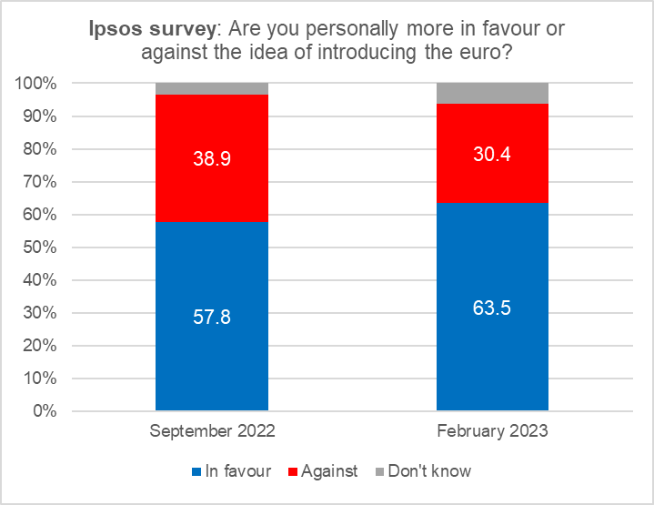
Public support for euro adoption in Croatia
The level of support was relatively high before the adoption of the euro ...
... and has increased further following the successful changeover
Source: Eurobarometer
Source: Ipsos

Slide 29
Concluding remarks
The euro adoption process has become much more demanding reflecting significant changes in the EMU’s institutional setup after the 2008-09 global financial crisis
as a result, Croatia had to go through a stricter formal euro adoption process than countries in the past
Croatia’s road to the euro was made even more challenging by severe shocks that hit the country in the period 2020-2022
the surge in global inflation in 2021-22 jeopardized Croatia’s ability to fulfil the nominal convergence criteria, and it also added to the (incorrect) public perception that the adoption of the euro led to a sharp increase in the price level
The euro brings significant and permanent economic benefits to small EU Member States in the form of lower exposure to risks, greater resilience to crises, higher cost efficiency and more favorable access to financing

Slide 30
Thank you for your attention!

