Slide 1
Inflation persistence and monetary policy
Slides
Huw Pill, Philip Schnattinger, Brad Speigner

Slide 2
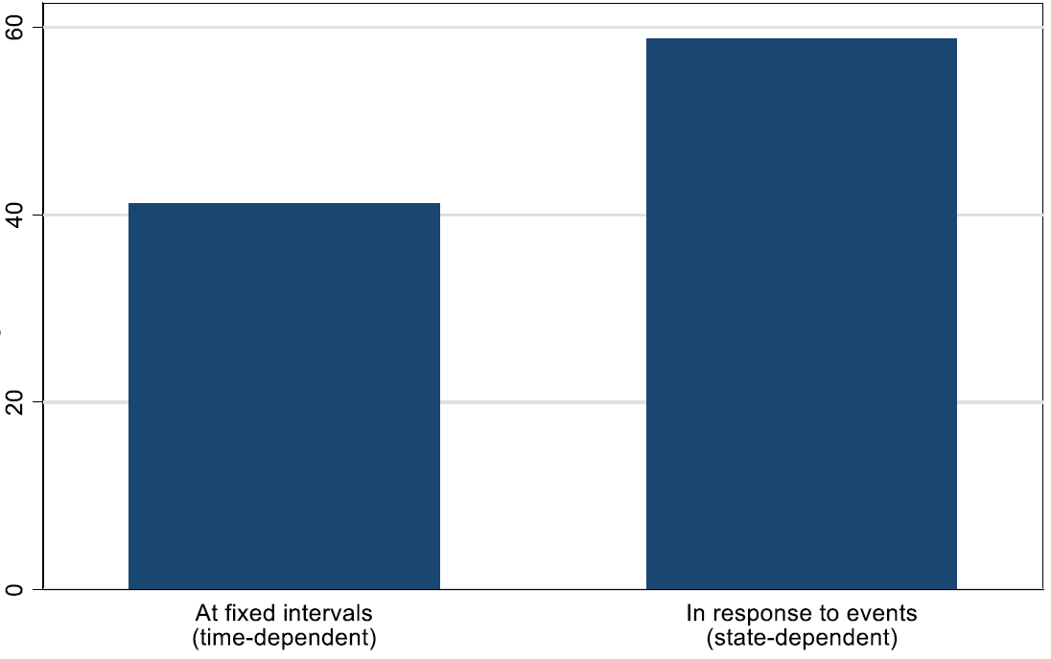
Firms pricing behaviour
Pricing behaviour
Time vs. State dependency, %
Time
State
Question wording – ‘Which of the following best describes how your business usually sets prices?’; (i) ‘Mostly change prices in response to specific events (e.g. changes in costs or demand)’; (ii) ‘Mostly change prices at fixed intervals (e.g. once a year or once a quarter, etc.)’
Source: Bank of England Decision Maker Panel survey

Slide 3
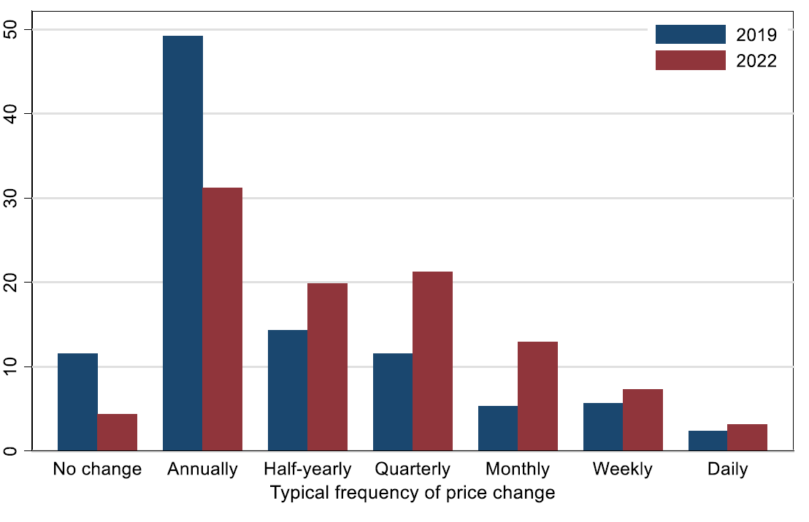
Firms pricing behaviour
Typical frequency of price changes
% of businesses surveyed
Question wording – ‘Approximately, how often did your prices change in each of the following years? Where possible, please consider the average across all products and services. If that is not possible, please answer for your main product/service.’
Source: Bank of England Decision Maker Panel survey

Slide 4
Firms pricing behaviour
Source: Bank of England Decision Maker Panel survey

Slide 5
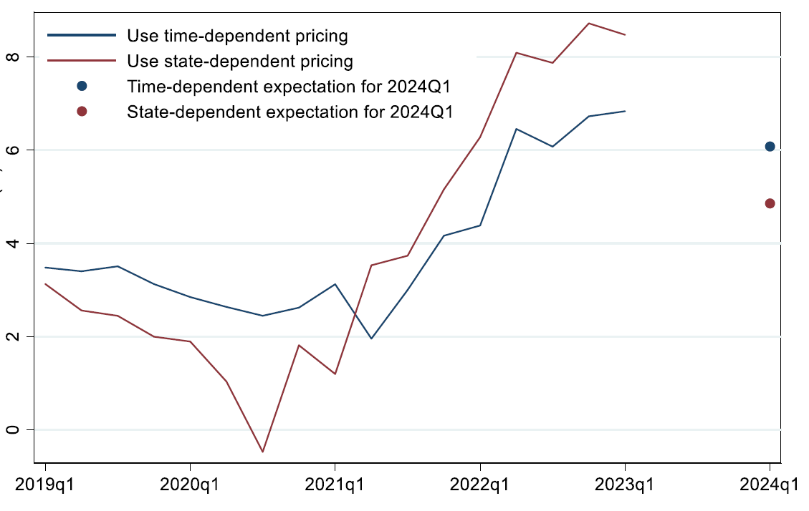
State-dependent pricing firms report a bigger rise in inflation …
… but also anticipate a
bigger decline in inflation
% of businesses surveyed
Source: Bank of England Decision Maker Panel survey

Slide 6


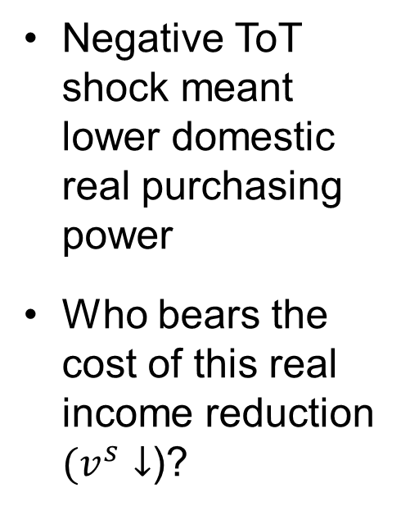



A negative Terms of Trade shock leaves less real income to distribute domestically …
Total Real Value Added
Total Real Value Added
To Imports
To Imports
Negative ToT shock meant lower domestic real purchasing power
Who bears the cost of this real income reduction $(v^{s}↓$)?
$$v_{ _1 }^{x}={q^{x}}^{ }p_{1}^{x}$$
$$y_{2}^{x}=p_{2 }^{x}q_{2}^{x}$$
$$p_{2}^{x}↑ ⇒v_{2}^{x}↑$$
To domestic producers and suppliers of inputs into production, e.g. workers, intermediate good producers, retailers, …
ToT shock
To domestic producers and suppliers of inputs into production, e.g. workers, intermediate good producers, retailers, …
$$v_{1}^{s}=\frac{y^{d}}{φp_{x}+ \left(1−φ\right)p^{d}}$$
$$p_{2}^{x}↑ ⇒v_{2}^{s}↓$$

Slide 7
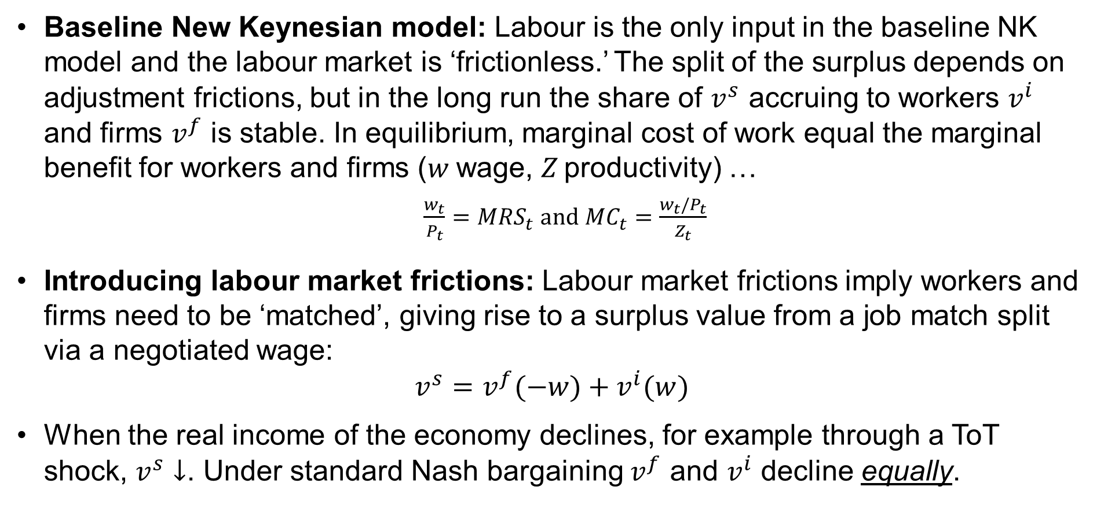
Splitting the remaining surplus after a negative ToT shock
Baseline New Keynesian model: Labour is the only input in the baseline NK model and the labour market is ‘frictionless.’ The split of the surplus depends on adjustment frictions, but in the long run the share of $v^{s}$ accruing to workers $v^{i}$ and firms $v^{f}$ is stable. In equilibrium, marginal cost of work equal the marginal benefit for workers and firms (w wage, Z productivity) …
  $\frac{w_{t}}{P_{t}}=MRS_{t} and$ $MC_{t}=\frac{w_{t}/P_{t}}{Z_{t}}$
Introducing labour market frictions: Labour market frictions imply workers and firms need to be ‘matched’, giving rise to a surplus value from a job match split via a negotiated wage:
$$v^{s}=v^{f}(−w)+v^{i}(w)$$
When the real income of the economy declines, for example through a ToT shock, $v^{s}↓$. Under standard Nash bargaining $v^{f}$ and $v^{i}$ decline equally.

Slide 8
Profit and labour shares in the UK
Note: Rates of return of UK non continental shelf, private non-financial corporations
Source: ONS
Source: ONS
The profit and labour share in value added have remained relatively stable. This could imply symmetric ‘push and shove’ between labour and capital.

Slide 9
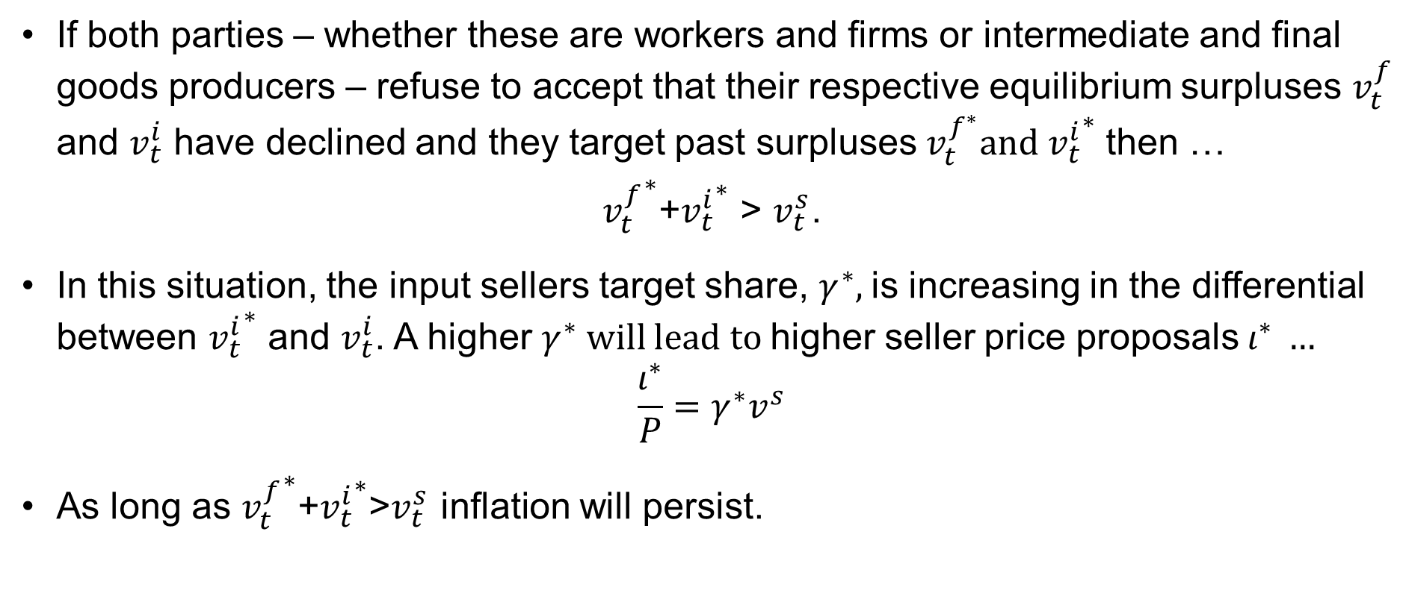
What happens when parties refuse to accept that the real income implications of ToT shock?
If both parties – whether these are workers and firms or intermediate and final goods producers – refuse to accept that their respective equilibrium surpluses $v_{t}^{f}$ and $v_{t}^{i}$ have declined and they target past surpluses${ v}_{t}^{f^{∗}}and {v_{t}^{i}}^{∗}$ then …
${v_{t}^{f}}^{∗}$+${v_{t}^{i}}^{∗}$ > $v_{t}^{s}$.
In this situation, the input sellers target share, $γ^{∗}$, is increasing in the differential between ${v_{t}^{i}}^{∗}$ and $v_{t}^{i}$. A higher $γ^{∗}$ will lead to higher seller price proposals$ι^{∗} …$
$$\frac{ι^{∗}}{P}=γ^{∗}v^{s}$$
As long as ${v_{t}^{f}}^{∗}$+${v_{t}^{i}}^{∗}$>$v_{t}^{s}$ inflation will persist.

Slide 10
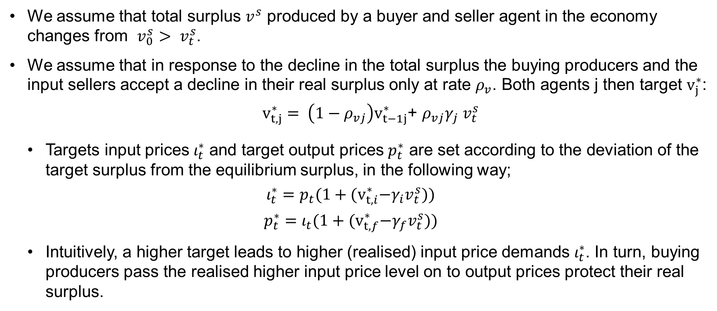
Mechanics of targeting a real surplus that is too high – creation of ‘push and shove’ inflation
We assume that total surplus $v^{s}$ produced by a buyer and seller agent in the economy changes from ${v_{0}^{s}> v}_{t}^{s}$.
We assume that in response to the decline in the total surplus the buying producers and the input sellers accept a decline in their real surplus only at rate $ρ_{v}$. Both agents j then target $v_{j}^{∗}$:
  $v_{t, j}^{∗}= \left(1−ρ_{vj}\right)v_{t−1j}^{∗}$+ $ρ_{vj}{γ_{j} v}_{t}^{s}$
  Targets input prices $ι_{t}^{∗}$ and target output prices $p_{t}^{∗}$ are set according to the deviation of the target surplus from the equilibrium surplus, in the following way;
  $$ι_{t}^{∗}={p_{t}(1+(v}_{t, i}^{∗}{−γ_{i}v}_{t}^{s}))$$
  $$p_{t}^{∗}={ι_{t}(1+(v}_{t, f}^{∗}{−γ_{f}v}_{t}^{s}))$$
  Intuitively, a higher target leads to higher (realised) input price demands $ι_{t}^{∗}$. In turn, buying producers pass the realised higher input price level on to output prices protect their real surplus.

Slide 11
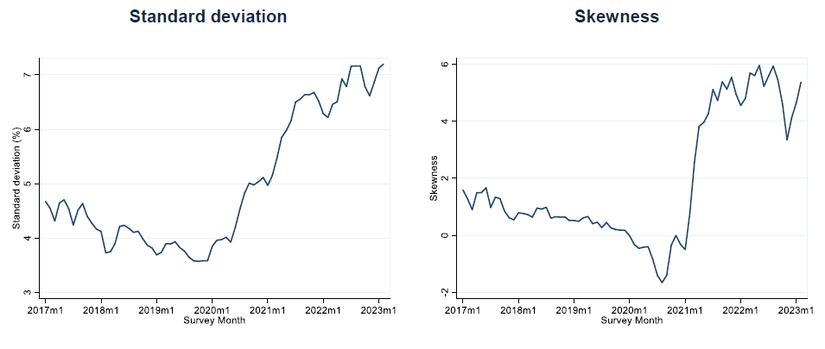
Price dispersion has risen showing pass-through, adjustments and price pushes are unequally distributed across firms
Source: Bank of England Decision Maker Panel survey

Slide 12
Wage dispersion across firms has also risen
Source: Bank of England Decision Maker Panel survey

Slide 13
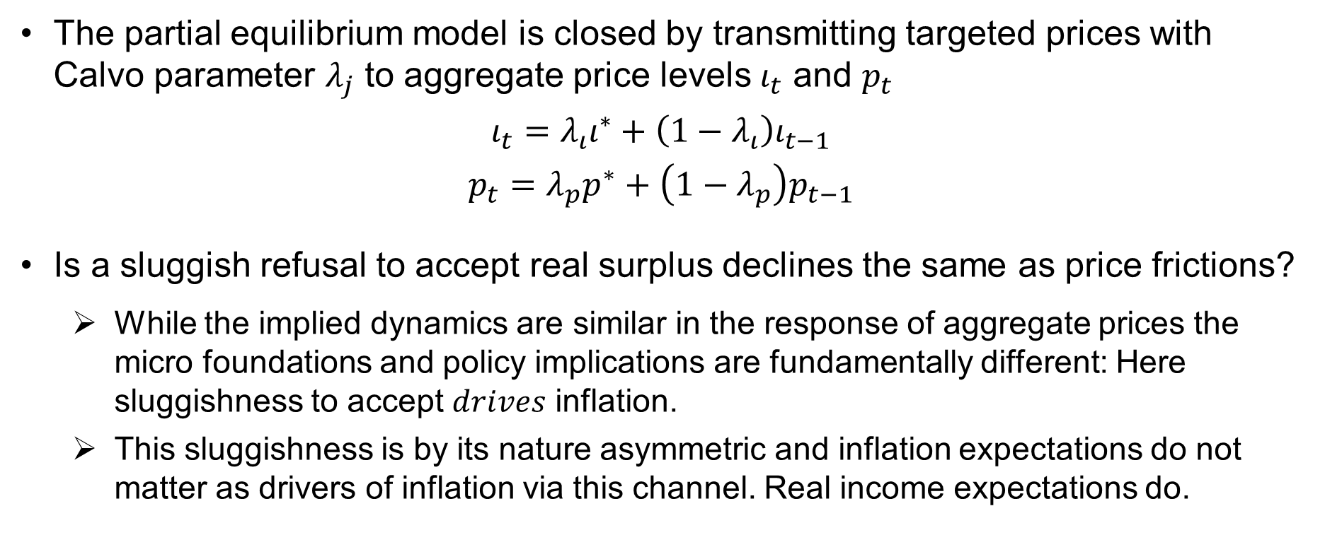
Mechanics of targeting a real surplus that is too high
The partial equilibrium model is closed by transmitting targeted prices with Calvo parameter $λ_{j}$ to aggregate price levels $ι_{t}$ and $p_{t}$
$$ι_{t}=λ_{ι}ι^{∗}+\left(1−λ_{ι}\right)ι_{t−1}$$
$$p_{t}=λ_{p}p^{∗}+\left(1−λ_{p}\right)p_{t−1}$$
Is a sluggish refusal to accept real surplus declines the same as price frictions?
  While the implied dynamics are similar in the response of aggregate prices the micro foundations and policy implications are fundamentally different: Here sluggishness to accept $drives$ inflation.
  This sluggishness is by its nature asymmetric and inflation expectations do not matter as drivers of inflation via this channel. Real income expectations do.

Slide 14
Illustrating the dynamics
In the next slides we show …
  A negative ToT shock at time 2
  A positive ToT shock at time 26 making up 50% of the negative ToT at time 2
  The fourth slide assumes that monetary policy can force a higher speed of acceptance. Intuitively this may be the result of interest rate increases reducing the bargaining power of input sellers, restricting their ability to raise the input price. And also cutting the demand for output produced, reducing the scope for output price increases.

Slide 15
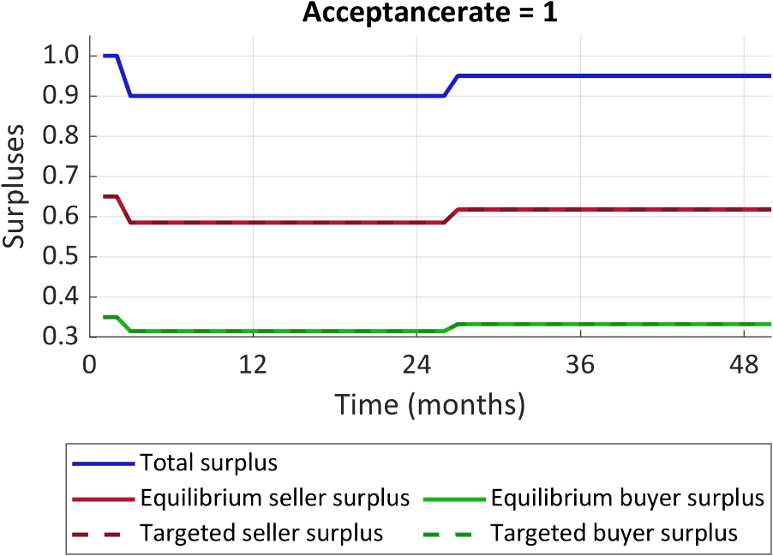
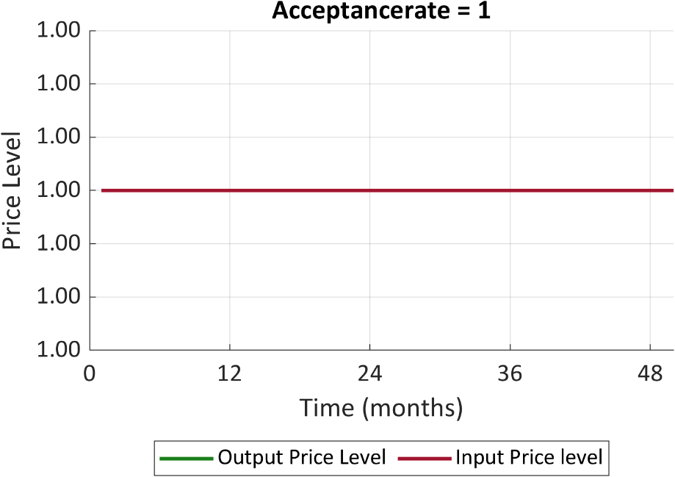
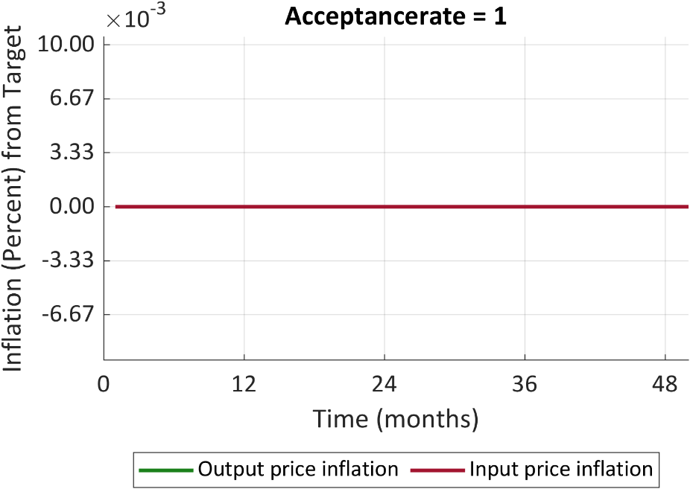
Immediate surplus decline acceptance
Immediate acceptance means no inflation caused by targeting too high real surpluses as the target surplus of both parties immediately adjusts

Slide 16
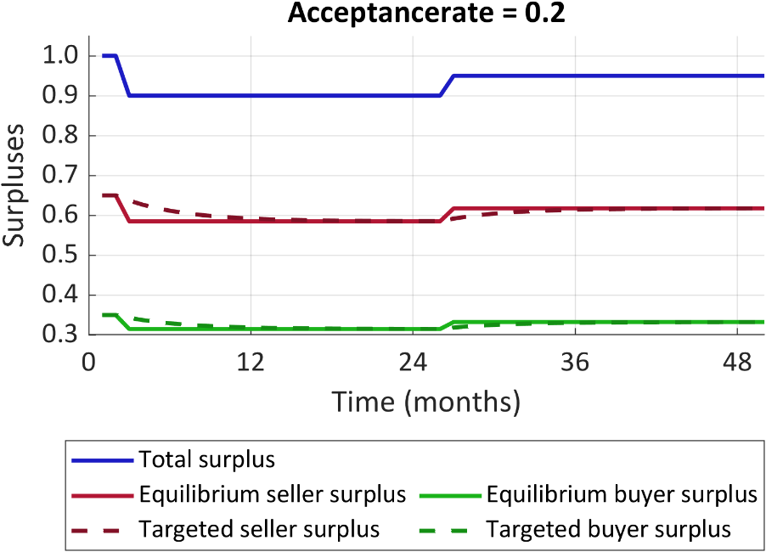
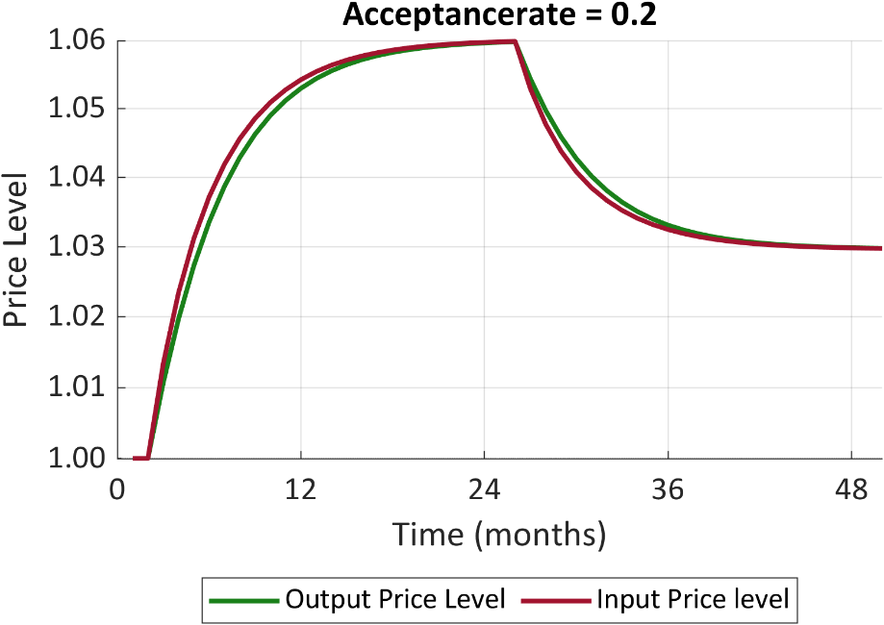
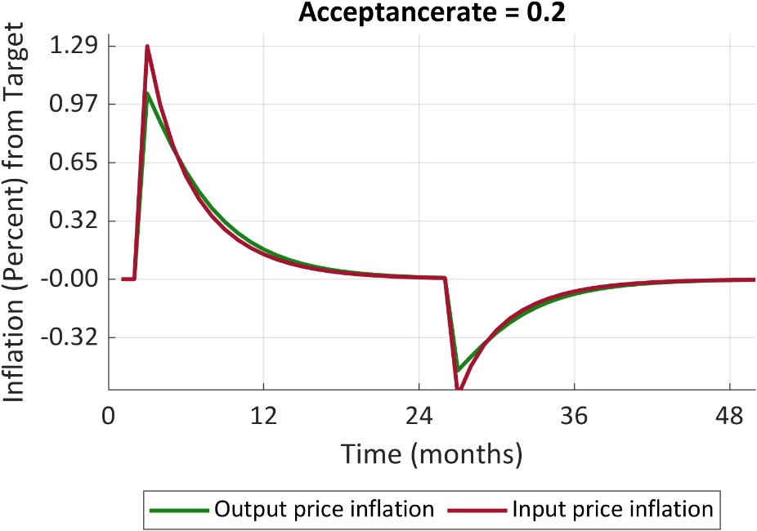
Sluggish (20%) surplus decline acceptance
  Sluggish acceptance leads to temporary inflation as targeted surpluses adjust to real surpluses. The positive terms of trade shock at time 26 has a negative effect on inflation provided real income increases are also sluggishly accepted.

Slide 17
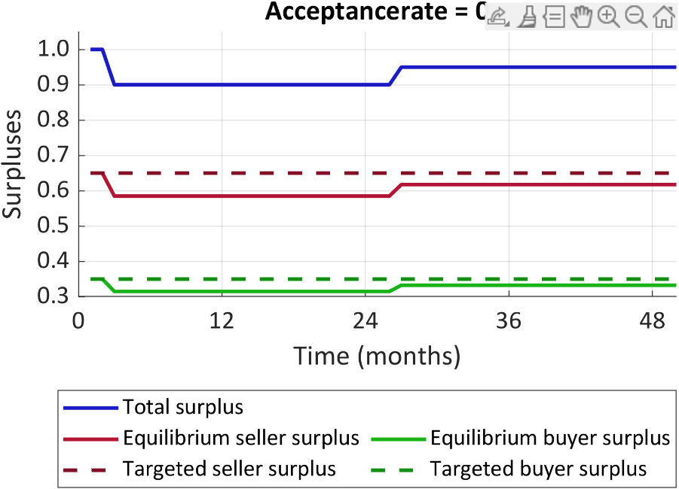
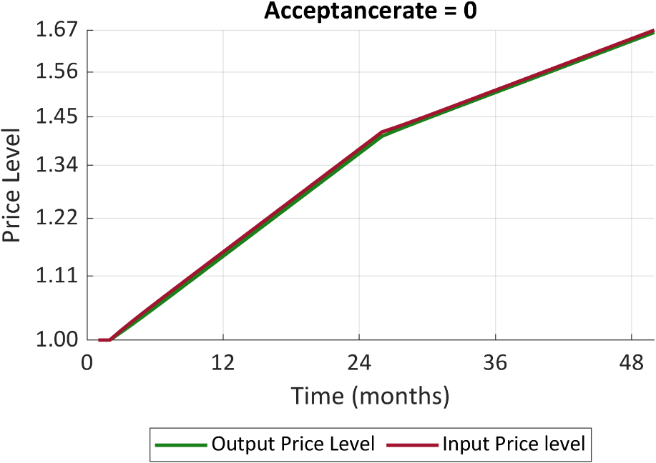
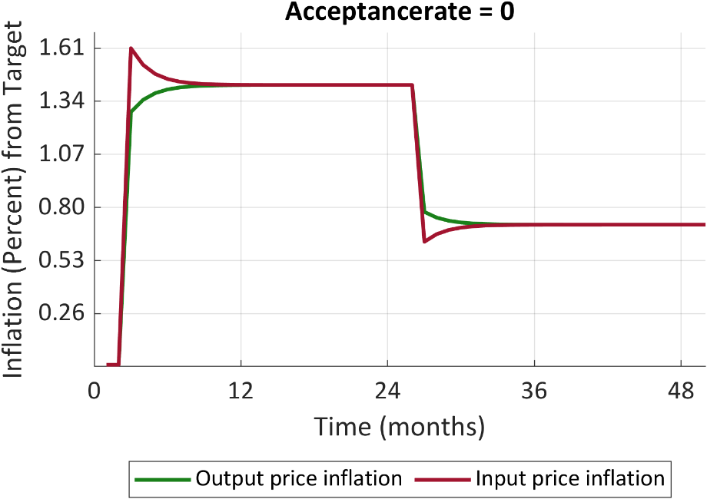
Acceptance of the surplus declines never happens
Acceptance rate = 0
  Refusal to accept decline in surplus means inflation increases persistently. The positive terms of trade shock at time 26 decreases inflation, but it is still positively increased compared to time 0.

Slide 18
Drivers of bargaining power – V/U ratio
Ratio of vacancies to unemployed
Source: ONS Labour Force Survey

Slide 19
Drivers of bargaining power – Labour market churn
Job-to-job flows
% of employed in previous period
Source: ONS Labour Force Survey

Slide 20
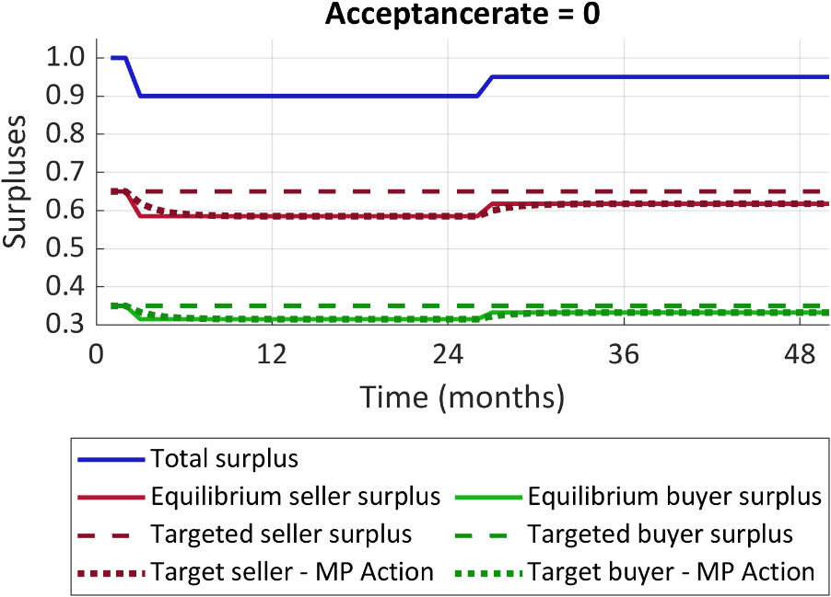
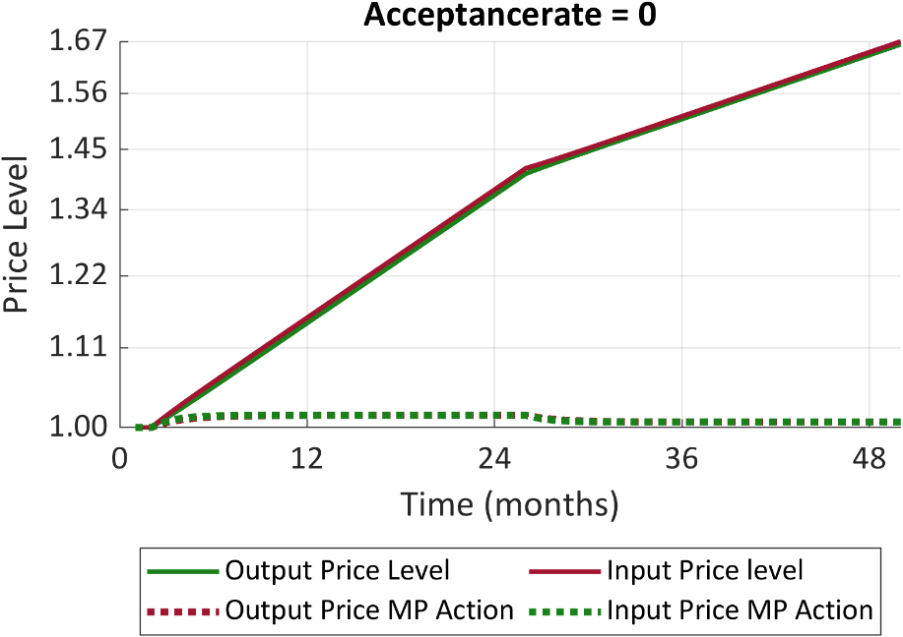
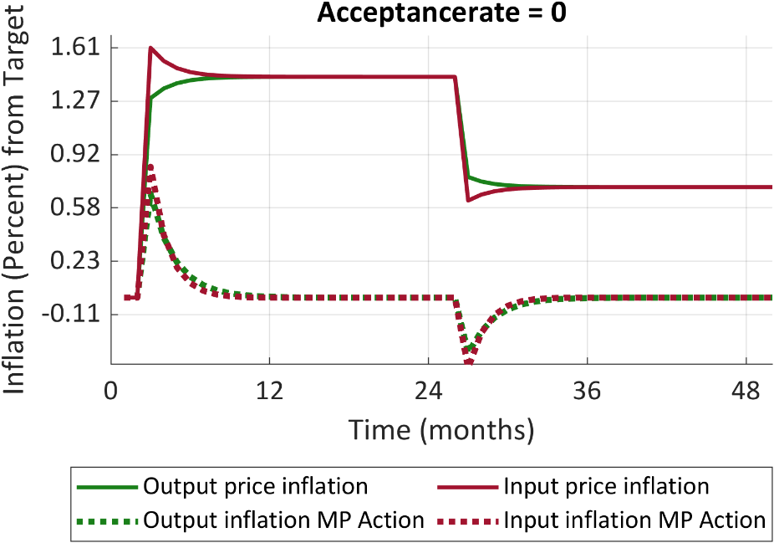
Acceptance of the surplus decline is facilitated by monetary policy action
  Monetary policy can facilitate a similar path to a sluggish acceptance of surplus decline. Compared to the refusal to accept, the dotted paths show that the increase in inflation will only be temporary elevated as the targeted surpluses are facilitated down.

Slide 21
Existing literature on the refusal to accept a real surplus decline
The framework in Layard Nickell Jackman has real wage resistance which encapsulates this concept for workers.
  In response to a real income shock the NAIRU rises.
  To get workers to accept the decline in income the bargaining power of the worker is being reduced by higher unemployment leading to eventual acceptance in the reduction of their surplus.
  Once sellers accept their decline in surplus, firms are no longer pushed to increase their prices and are encouraged to accept a surplus decline as average buyer bargaining power falls.
Other resolution: Reversal of the ToT shock, increasing productivity, increasing labour supply.
Refusal to accept a surplus decline may be further micro founded by real adjustment costs to income declines or minimum income requirements for input sellers and buyers to continue production.

Slide 22
References
Pissarides, C.A. (2000). Equilibrium unemployment theory. MIT Press
Layard, R., S.J. Nickell and R. Jackman (2005). Unemployment: Macroeconomic performance and the labour market. Oxford University Press
Blanchard, O., and J. Galí (2007). “Real wage rigidities and the New Keynesian model,” Journal of money, credit and banking 39, pp. 35-65
Broadbent, B. (2016). “The distributional implications of low structural interest rates and some remarks about monetary policy trade-offs,” speech to the Society of Business Economists Annual Conference
Lorenzoni, G., and I. Werning (2023). Wage price spirals, MIT working paper

