Slide 1
Jean-Claude Trichet Former President of the European Central Bank What governance for the Eurozone?
ICMB Conference
November 2017

Slide 2
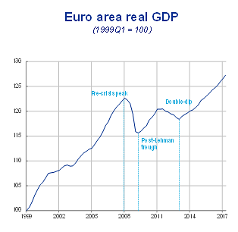
The recovery of economic activity in the euro area
Centre International d’Études Monétaires et Bancaires (CIMB)
Genève – Novembre 2017
Jean-Claude Trichet

Slide 3
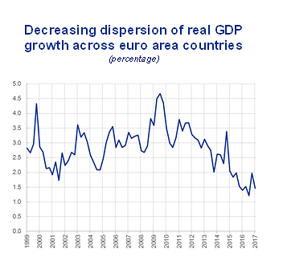
The recovery of economic activity in the euro area
Centre International d’Études Monétaires et Bancaires (CIMB)
Genève – Novembre 2017
Jean-Claude Trichet

Slide 4
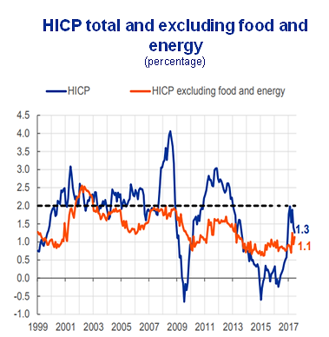
Inflation and Unemployment improved but still not normalized
Centre International d’Études Monétaires et Bancaires (CIMB)
Genève – Novembre 2017
Jean-Claude Trichet

Slide 5
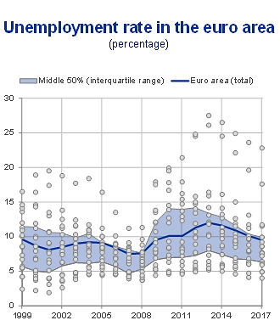
Inflation and Unemployment improved but still not normalized
Centre International d’Études Monétaires et Bancaires (CIMB)
Genève – Novembre 2017
Jean-Claude Trichet

Slide 6
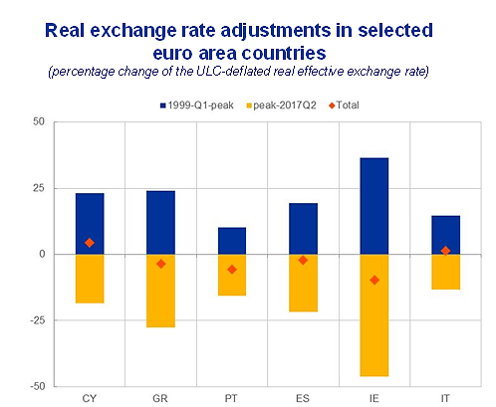
Adjustment in the periphery: Internal devaluation
Centre International d’Études Monétaires et Bancaires (CIMB)
Genève – Novembre 2017
Jean-Claude Trichet

Slide 7
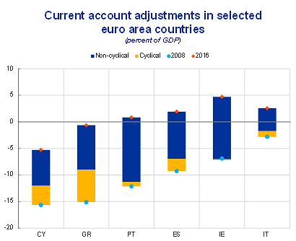
Adjustment in the periphery: Sustainable current account corrections
Centre International d’Études Monétaires et Bancaires (CIMB)
Genève – Novembre 2017
Jean-Claude Trichet

Slide 8
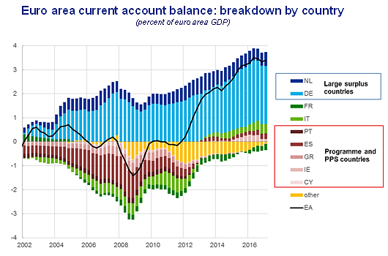
Adjustment in the euro area: current account balances

Slide 9
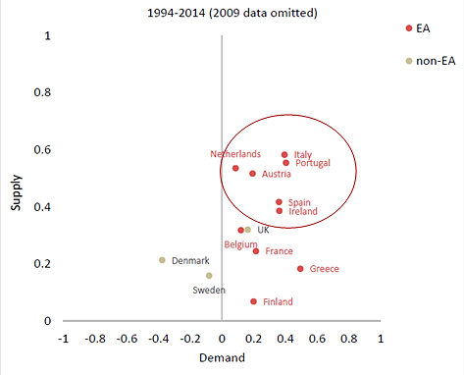
Cycle synchronization: Former periphery correlated with the core in 1990-2014
Euro Area vs. non-Euro countries
Centre International d’Études Monétaires et Bancaires (CIMB)
Genève – Novembre 2017
Jean-Claude Trichet

Slide 10
Sources The recovery of economic activity in the euro area : ECB Inflation and Unemployment improved but still not normalized : Eurostat. Latest observation: June 2017 Eurostat and ECB staff calculations. Note: For any given year, the shaded area contains the middle 50% of the growth rates (“interquartile range”). The observation for 2017 is based on 2017Q1. Each dot represents a country-year observation. Adjustment in the periphery: Internal devaluation : ECB Adjustment in the periphery: sustainable current account corrections: ECB staff estimations. Note: The estimates are based on an empirical modelling the current account balance to a broad set of cyclical fundamental and policy variables. Adjustment in the euro area - current account balances : ECB and Eurostat. Note: “Other” includes a statistical discrepancy term scheme data at the country level do not necessarily add up to the euro area total. Cycle synchronization: Former periphery correlated with the core in 1990-2014 : Bayoumi, T. and B. Eichengreen (2017) “Aftershocks of monetary unification: hysteresis with a financial twist” IMF WP/17/55

